Slide 1


Patrick Zhang
30 January 2024

Slide 2

Outline
Executive Summary
Introduction
Methodology
Results
Conclusion
Appendix

Slide 3
Executive Summary
Summary of methodologies
Data Collection with APIs and Web Scrapping
Data Wrangling
Exploratory Data Analysis (EDA) with SQL and Data Visualization
Interactive Maps using Folium
Interactive Dashboard using Plotly Dash
Predictive Analysis using Machine Learning
Summary of all results
EDA results
Interactive maps and dashboard
Predictive results

Slide 4
Introduction
Project background and context
SpaceX advertises Falcon 9 rocket launches on its website, with a cost of 62 million dollars; other providers cost upward of 165 million dollars each. Much of the savings is because SpaceX can reuse the first stage. Therefore, if we can determine if the first stage will land, we can determine the cost of a launch. In this project, we will predict if the Falcon 9 first stage will land successfully.
Problems you want to find answers
What characterizes a successful or failed landing?
Are there any relationships between rocket variables that determine the outcome of a landing?
What must be done to achieve the best landing success rate?

Slide 5

Section 1

Slide 6
Methodology
Executive Summary
Data collection methodology:
Data was collected using the SpaceX API and web scrapping from Wikipedia.
Perform data wrangling
Irrelevant columns were dropped
One hot encoding applied to categorical variables.
Perform exploratory data analysis (EDA) using visualization and SQL
Perform interactive visual analytics using Folium and Plotly Dash
Perform predictive analysis using classification models
How to build, tune, evaluate classification models

Slide 7
Data Collection
Data was collected using the SpaceX API and web scrapping from Wikipedia.
The first step was collecting data from the SpaceX API.
Generate a response using the GET request
Decode the response as a JSON and convert into a Pandas dataframe.
The data was cleaned by checking for missing values and filling in the missing values where necessary.
After collecting the data from the API, web scrapping was performed to collect Falcon 9 historical launch data from Wikipedia.

Slide 8
Data Collection – SpaceX API
Get Response from SpaceX API
Convert Response into JSON
Get More Information about Launches by Using Custom Functions on API
Create Dictionary from Data Obtained
Create Pandas Dataframe
Filter data to only include Falcon 9 launches
Replace missing values using the average value of the Payload Mass column
Export data into CSV file
GitHub link to notebook

Slide 9
Data Collection - Scraping
Request Falcon 9 Launch page from Wikipedia
Convert Response into a BeautifulSoup Object
Extract All Column/Variable Names from the HTML Table Header
Parsing HTML Tables to Obtain Data
Create Dictionary from Data Obtained
Export data into CSV file
Create Dataframe from Dictionary
GitHub link to notebook

Slide 10
Data Wrangling
In the dataset, there are some cases where the booster landing was unsuccessful.
True Ocean, True RTLS, and True ASDS indicate a successful mission
False Ocean, False RTLS, and False ASDS indicate a failed mission
Strings were transformed into categorical variables.
1 indicates a successful mission
0 indicates a failed mission
Perform Exploratory Data Analysis (EDA)
Calculate Number of Launches on Each Site
Calculate Number and Occurrence of Each Orbit
Calculate Number and Occurrence of Mission Outcome of the Orbits
Create Landing Outcome Label from Outcome Column
Export data into CSV
GitHub link to notebook

Slide 11
EDA with Data Visualization
The following charts were plotted
Flight Number vs. Payload (Scatterplot)
Flight Number vs. Launch Site (Scatterplot)
Payload vs. Launch Site (Scatterplot)
Success Rate vs. Orbit (Bar Graph)
Flight Number vs. Orbit Type (Scatterplot)
Payload vs. Orbit Type (Scatterplot)
Success Yearly Trend (Line Graph)
Scatterplots show relationships between variables, known as correlation.
Bar graphs show relationships between numerical and categorical variables
Line graphs show trends over time
GitHub link to notebook

Slide 12
EDA with SQL
The following queries were performed:
Displaying the names of the unique launch sites in the space mission
Displaying 5 records where launch sites begin with the string 'CCA’
Displaying the total payload mass carried by boosters launched by NASA (CRS)
Displaying average payload mass carried by booster version F9 v1.1
Listing the date when the first successful landing outcome in ground pad was achieved.
Listing the names of the boosters which have success in drone ship and have payload mass greater than 4000 but less than 6000
Listing the total number of successful and failure mission outcomes
Listing the names of the booster_versions which have carried the maximum payload mass
Listing the records which will display the month names, failure landing_outcomes in drone ship ,booster versions, launch_site for the months in year 2015.
Ranking the count of landing outcomes (such as Failure (drone ship) or Success (ground pad)) between the date 2010-06-04 and 2017-03-20, in descending order.
GitHub link to notebook

Slide 13
Build an Interactive Map with Folium
All launch sites were marked
Objects such as circles and lines were added to the map to indicate the success or failure of the launches for each launch site
Red colored markers indicated failed launches while green colored markers indicated successful launches
Lines indicated distances from one launch site to its proximities like a highway, railway, and coastline.
GitHub link to notebook

Slide 14
Build a Dashboard with Plotly Dash
The interactive dashboard contained a dropdown menu, pie chart, slider and scatterplot.
The dropdown menu allows users to choose all launch sites or a particular one
A pie chart shows the total number of the successful launches for all sites.
If a particular site is chosen, it shows the total number successful launches and the total number of failed launches
A slider allows users to choose the payload mass in a range.
A scatterplot shows the correlation between payload mass and successful launches.
GitHub link to Code

Slide 15
Predictive Analysis (Classification)
Create array from the Class column
Standardize and transform the data
Split data into test and training sets
Create GridSearchCV object with cv = 10 to find best parameters
Applying the object on LogReg, SVM, Decision Tree, and KNN models
Calculate test data accuracy for all models
Examine confusion matrix for all models
Find out which method performs the best
GitHub link to notebook

Slide 16
Results
Exploratory data analysis results
Interactive analytics demo in screenshots
Predictive analysis results

Slide 17

Section 2

Slide 18
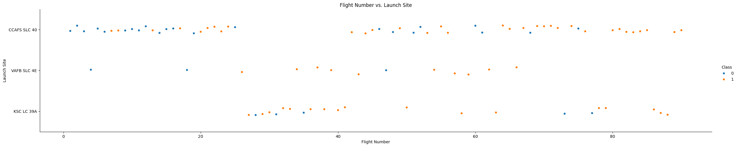
Flight Number vs. Launch Site
Based on the graph, we can observe the following:
Earlier flights mostly failed while later flights mostly succeeded
VARB SLC 4E and KSC LC 39A have higher success rates

Slide 19
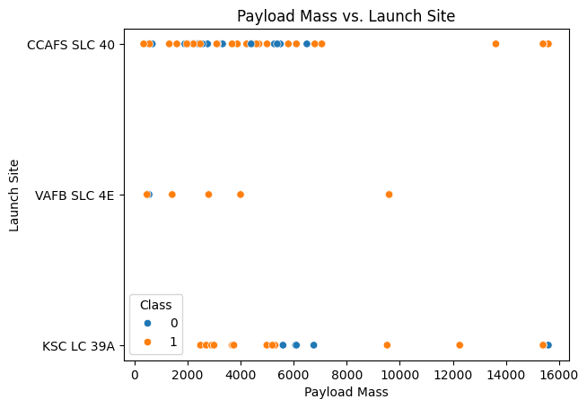
Payload vs. Launch Site
Based on the graph, we can observe the following:
Most launches with a payload mass of 7000 kg tend to succeed.
KSC LC 39A has a 100% success rate for payload masses under 5000 kg

Slide 20
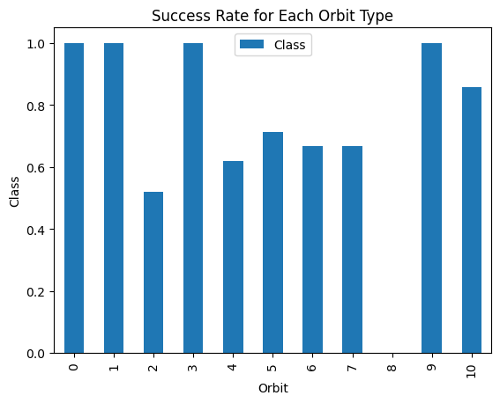
Success Rate vs. Orbit Type
 | Orbit | Class
0 | ES-L1 | 1.000000
1 | GEO | 1.000000
2 | GTO | 0.518519
3 | HEO | 1.000000
4 | ISS | 0.619048
5 | LEO | 0.714286
6 | MEO | 0.666667
7 | PO | 0.666667
8 | SO | 0.000000
9 | SSO | 1.000000
10 | VLEO | 0.857143
From the graph, ES-L1, GEO, HEO, and SSO have the best success rate.

Slide 21
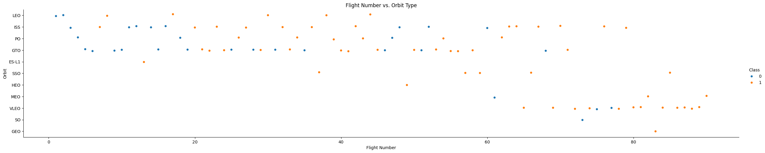
Flight Number vs. Orbit Type
Based on the graph, we can observe the following:
There’s a relationship between the LEO orbit and the number of flights
There’s no relationship between the GTO orbit and the number of flights

Slide 22
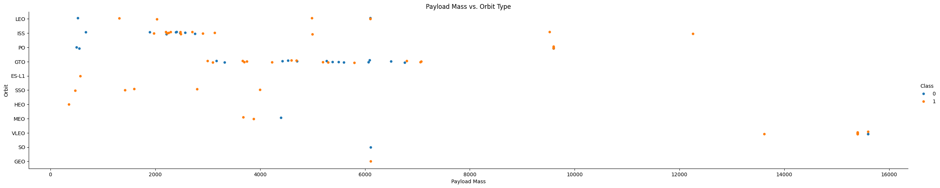
Payload vs. Orbit Type
Based on the graph, we can observe the following:
Heavy payloads have a negative influence on the GTO orbit
Have payloads have a positive influence on the PO, LEO, and ISS orbits

Slide 23
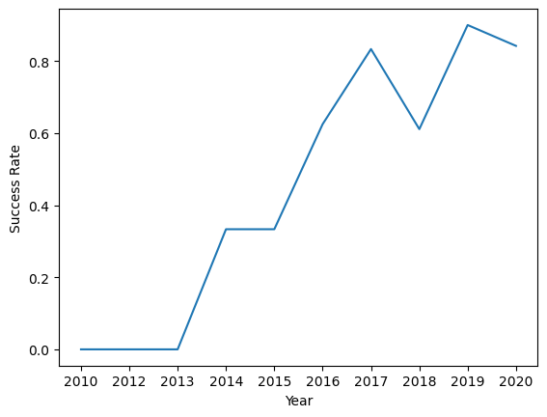
Launch Success Yearly Trend
Since 2013, the success rate has increased overall.

Slide 24
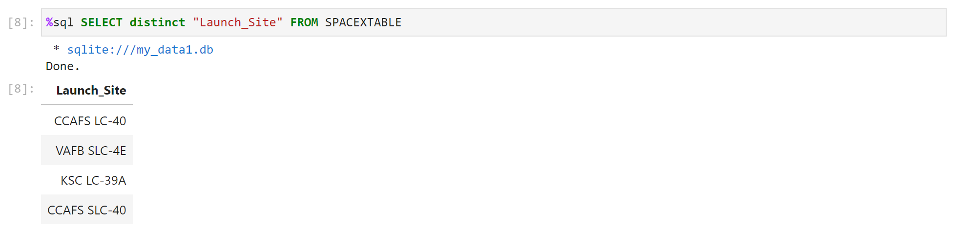
All Launch Site Names
By using the DISTINCT clause, it only shows unique launch sites.

Slide 25
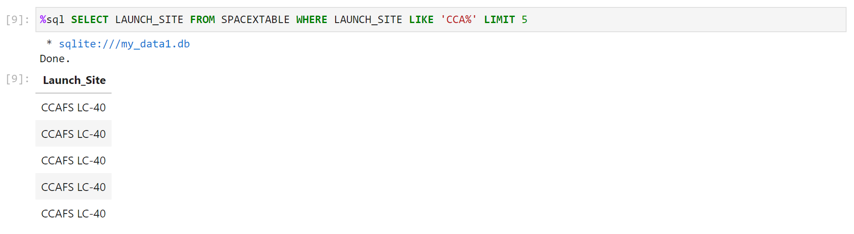
Launch Site Names Begin with 'CCA'
When using the WHERE clause along with the LIKE clause, we filter the launch site names that contain the substring ‘CCA’. By using the LIMIT clause, we only see 5 records.

Slide 26
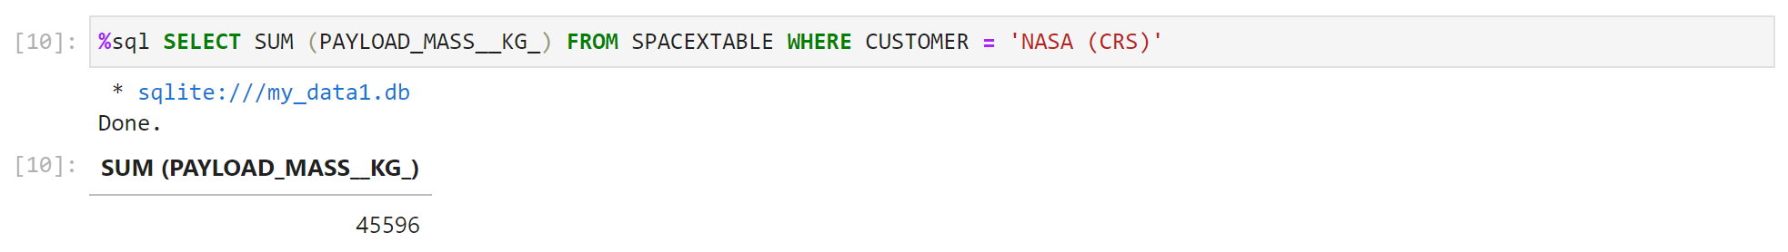
Total Payload Mass
This query shows the sum of the payload masses for the customer, NASA (CRS).

Slide 27
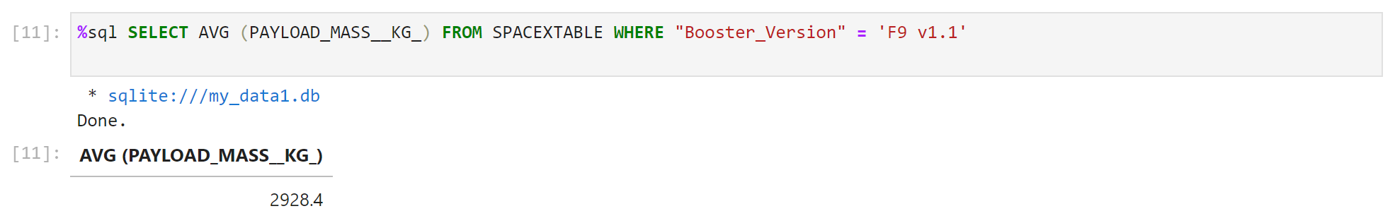
Average Payload Mass by F9 v1.1
This query shows the average payload mass carried by the Booster Version F9 v1.1

Slide 28
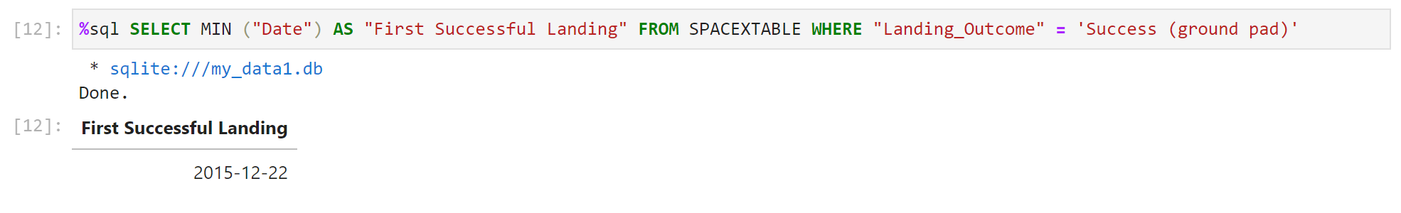
First Successful Ground Landing Date
The records are being filtered using the WHERE clause to show only successful landings in ground pad. Using the MIN clause gets the record with the oldest date.

Slide 29
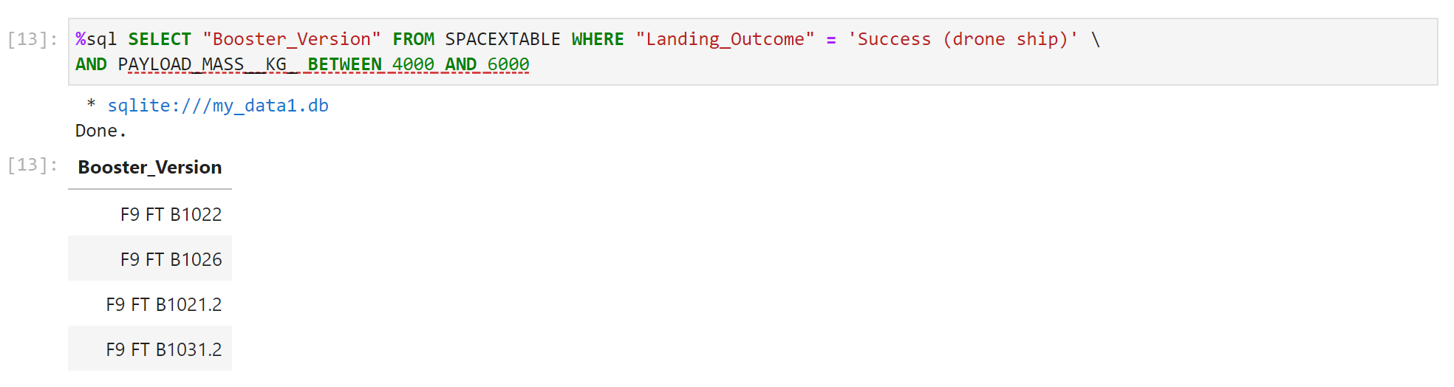
Successful Drone Ship Landing with Payload between 4000 and 6000
The records are being filtered using the WHERE clause to show only successful landings in drone ship. Additionally, the BETWEEN clause was used to filter landings with payload masses between 4000 and 6000.

Slide 30
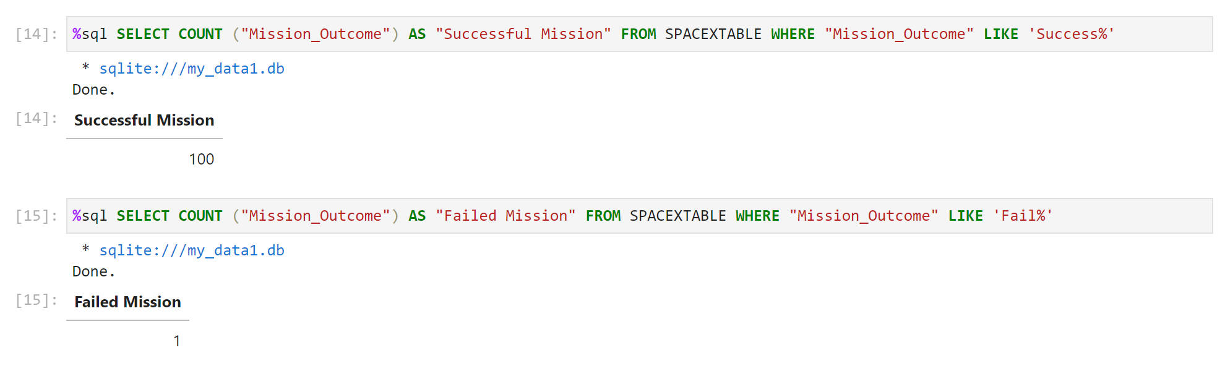
Total Number of Successful and Failure Mission Outcomes
The COUNT clause was used to get the total number of successful or failed missions. The LIKE clause and the ‘%’ wildcard was used to filter the outcomes where the word ‘success’ or ‘fail’ appeared.

Slide 31
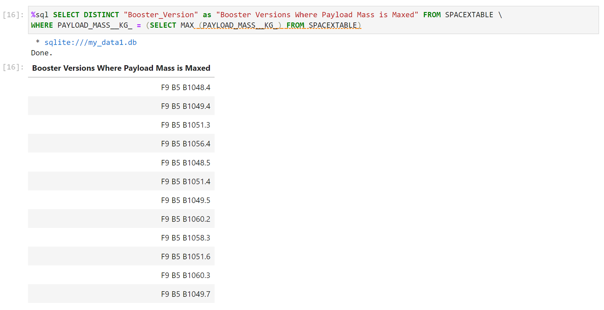
Boosters Carried Maximum Payload
The DISTINCT clause gets all the unique booster version names. The maximum payload mass is acquired using the MAX function and using it with the WHERE clause gets the booster versions that carried the maximum payload.

Slide 32
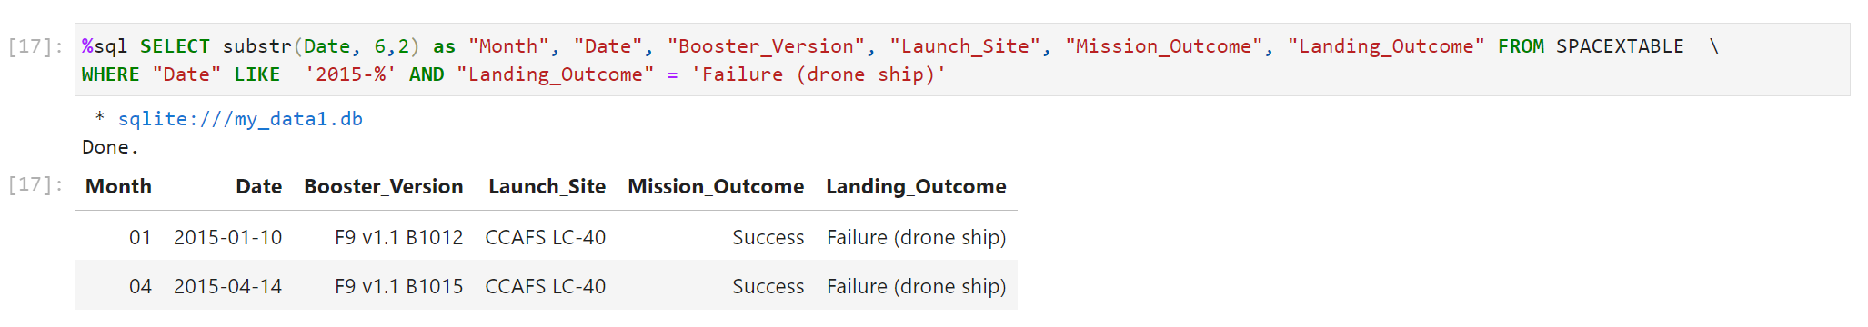
2015 Launch Records
This query uses a combination of the WHERE, AND, and LIKE clauses to filter records for the year 2015 and get boosters and launch sites with successful missions, but failed landings in drone ship.

Slide 33
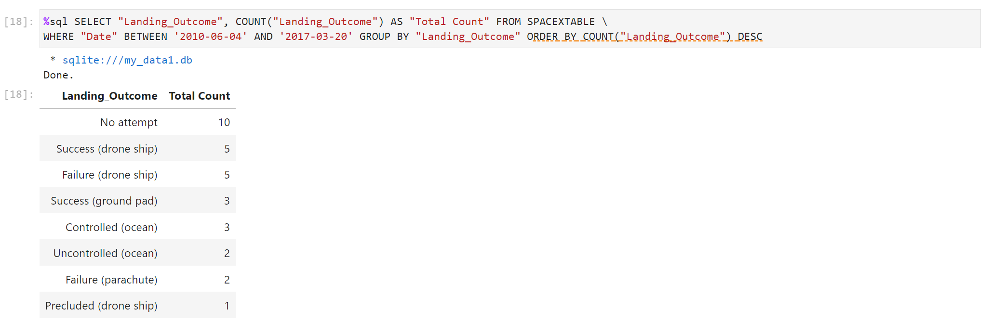
Rank Landing Outcomes Between 2010-06-04 and 2017-03-20
Using the BETWEEN clause filtered the records for landings between 2010-06-04 and 2017-03-20. All landing outcomes are grouped together by the GROUP BY clause and the ORDER BY COUNT orders the results in descending order by the total count of landings with that particular outcome.

Slide 34

Section 3

Slide 35
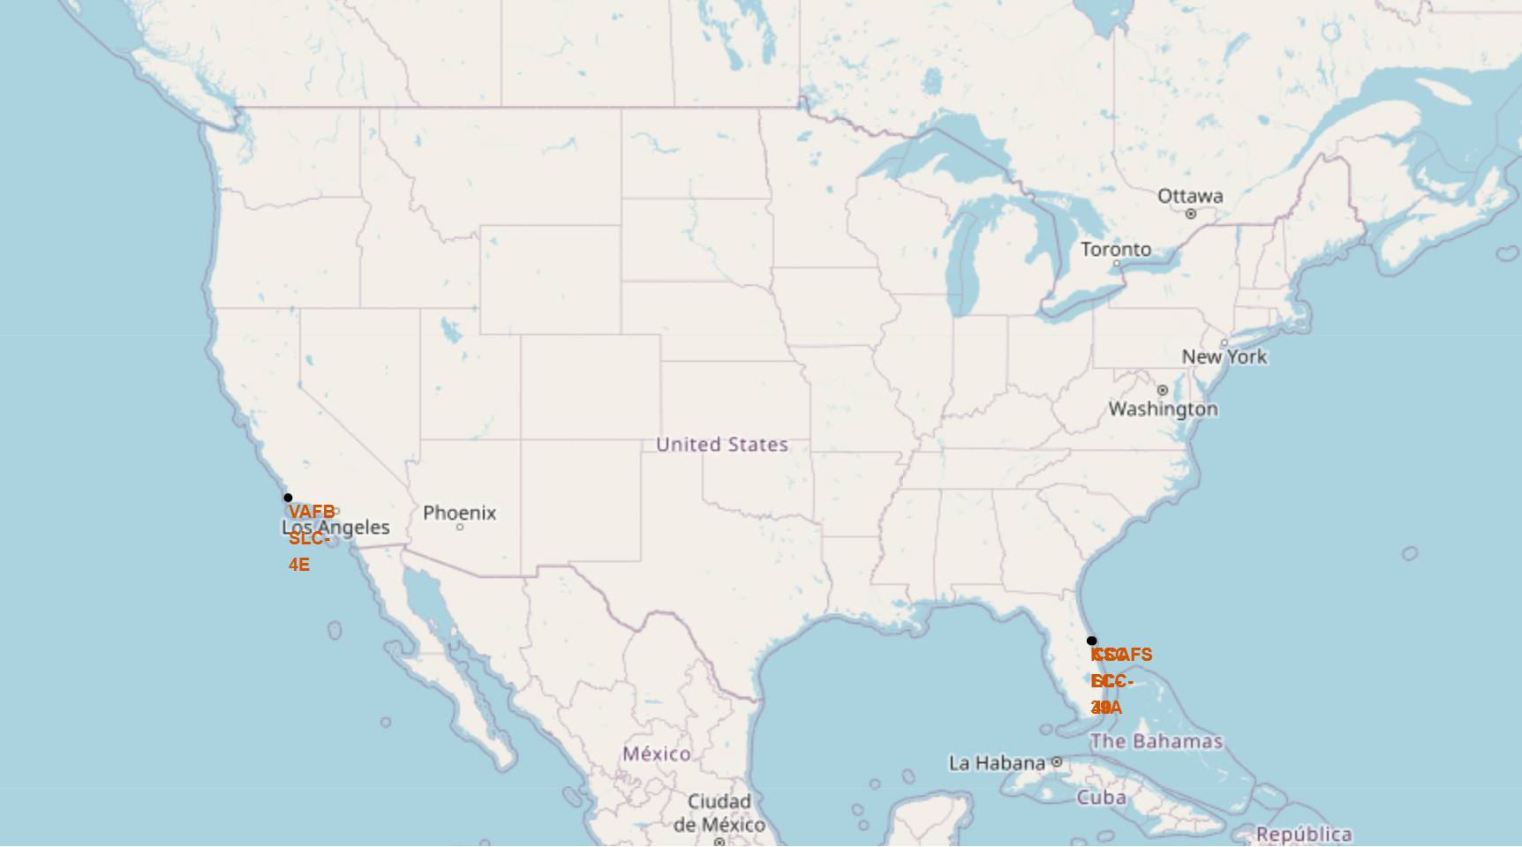
Launch Site Locations
All the SpaceX launch sites are located on the coasts of Florida and California in the USA.

Slide 36
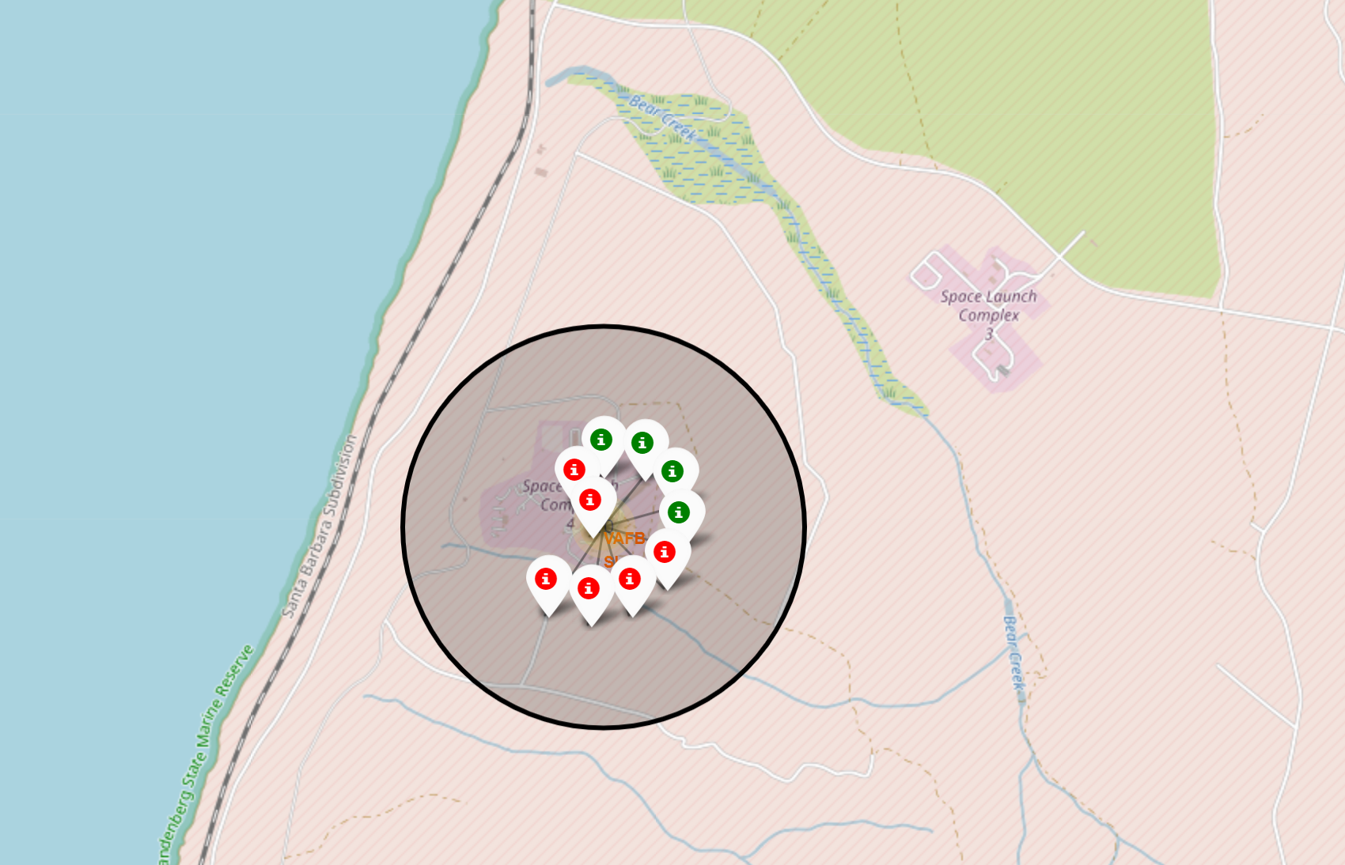
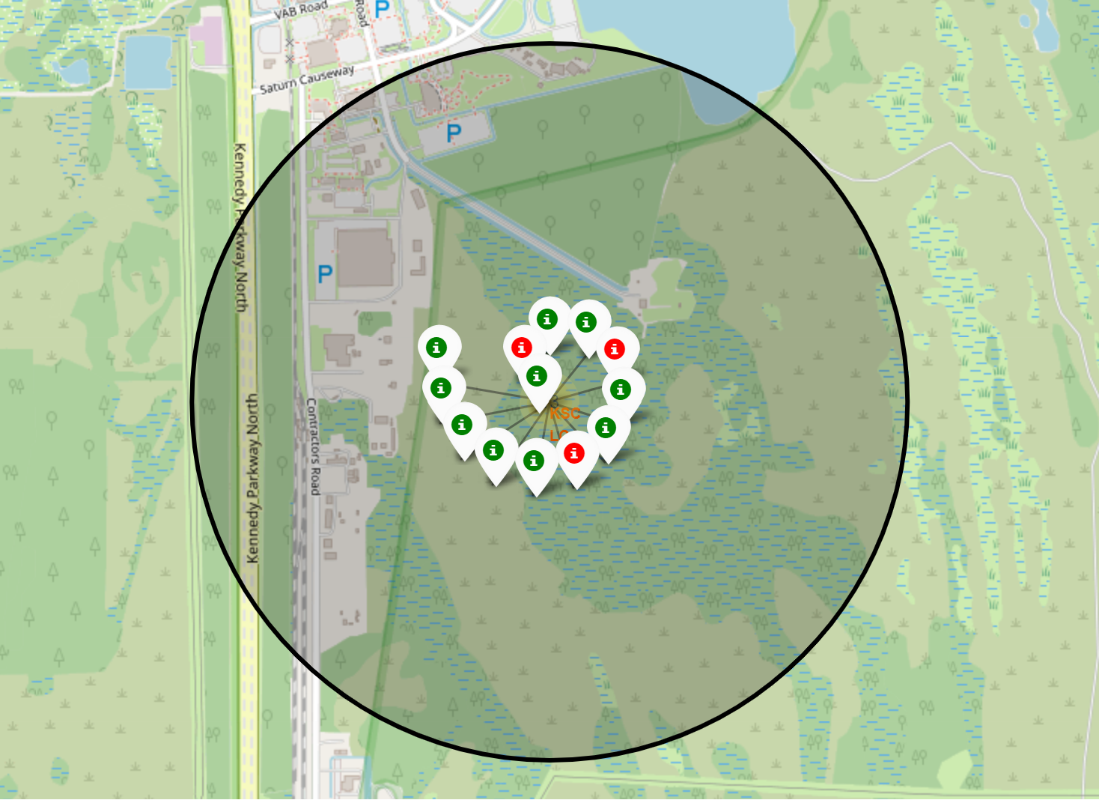
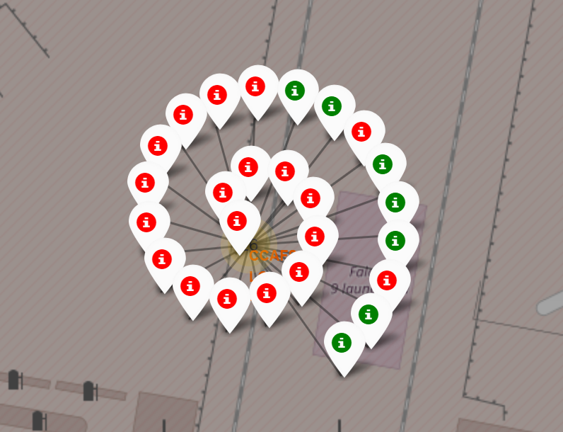
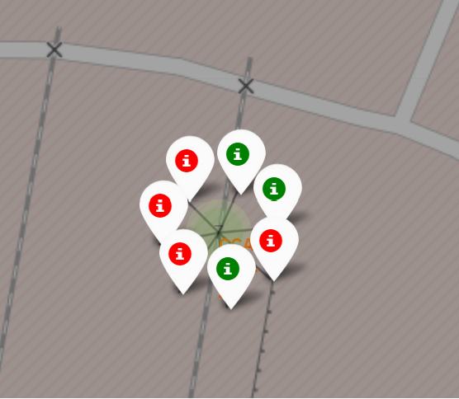
Colored Labeled Launch Records
California Launch Site
Florida Launch Sites
Based on the screenshots, we can observe the following:
Red indicates failed launches while green indicates successful launches.
The KSC LC-39A launch site had the highest success rate

Slide 37
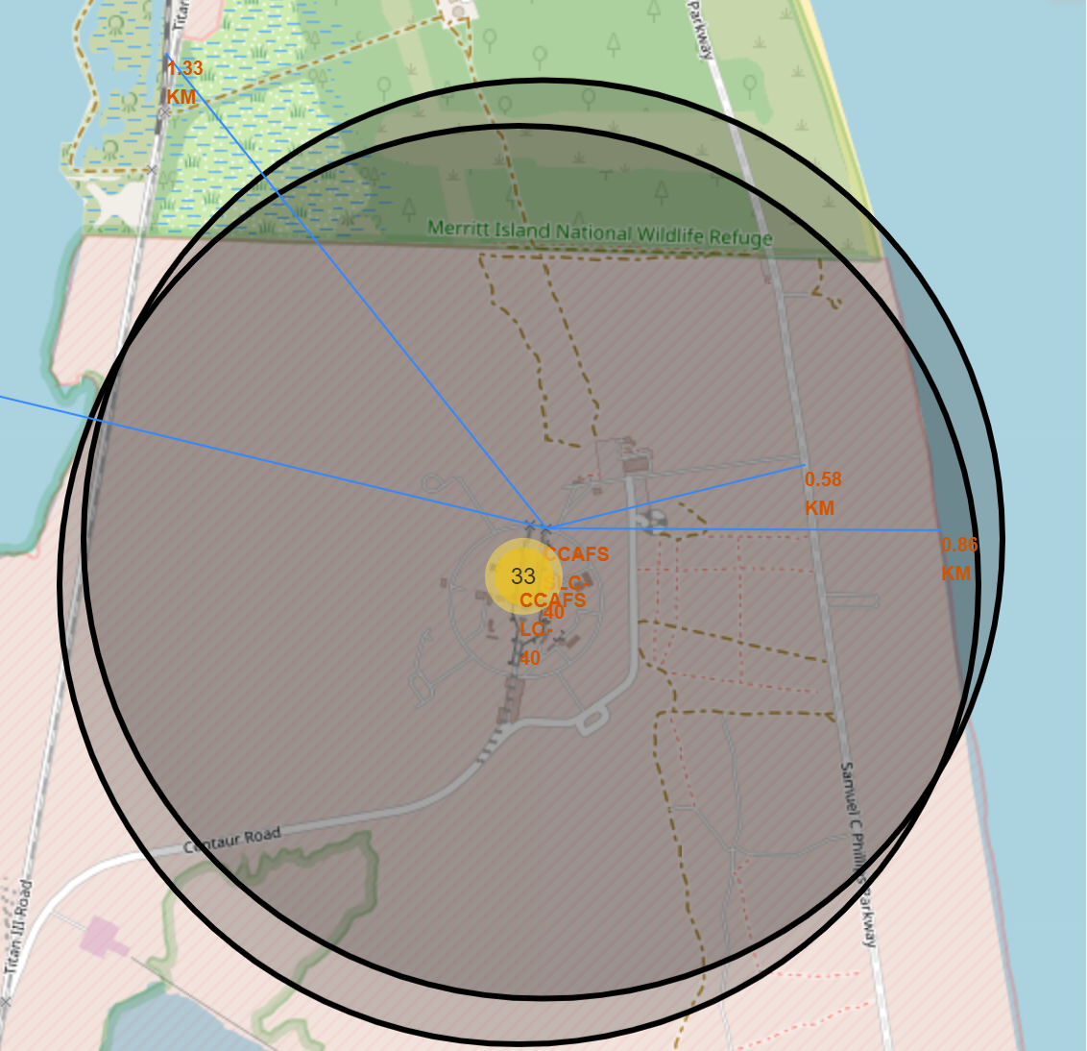
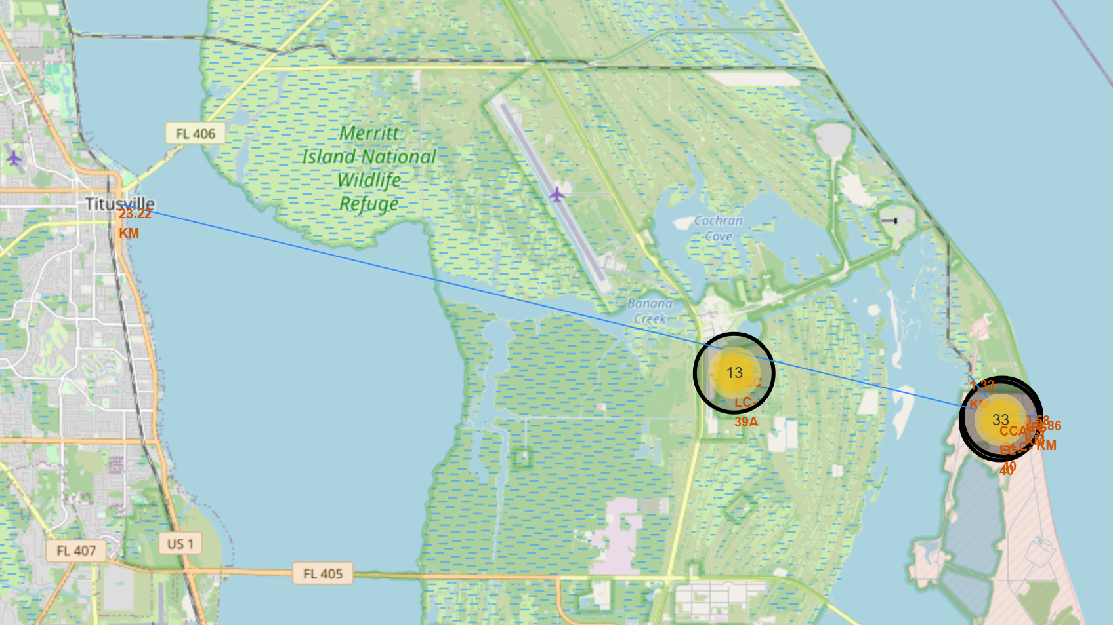
<Folium Map Screenshot 3>
Are launch sites in close proximity to railways? Yes
Are launch sites in close proximity to highways? Yes
Are launch sites in close proximity to coastline? Yes
Do launch sites keep certain distance away from cities? No

Slide 38

Section 4

Slide 39
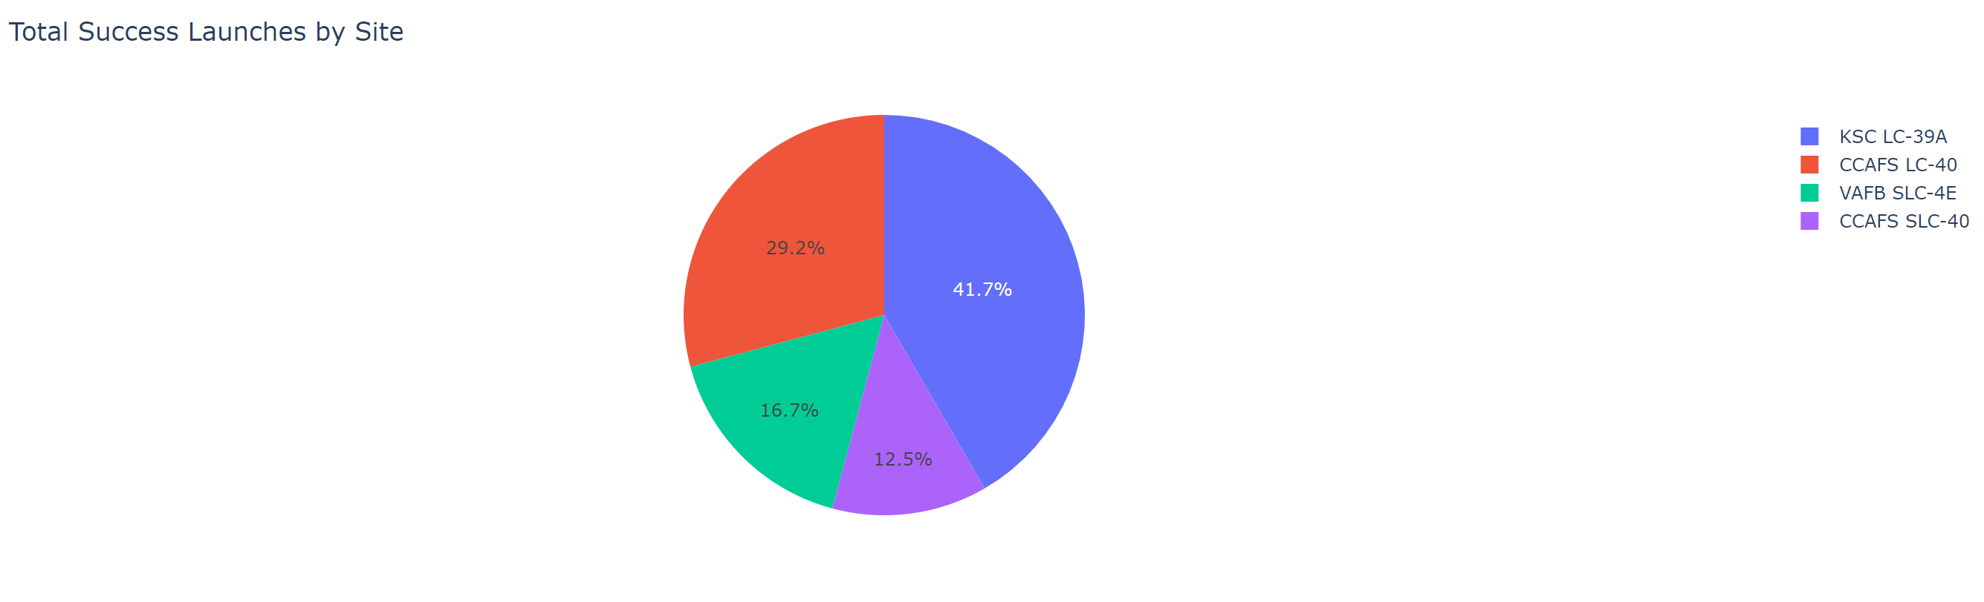
Total Successful Launches by Launch Site
The chart shows the number of successful launches for all the launch sites. KSC LC-39A has the most successful launches.

Slide 40
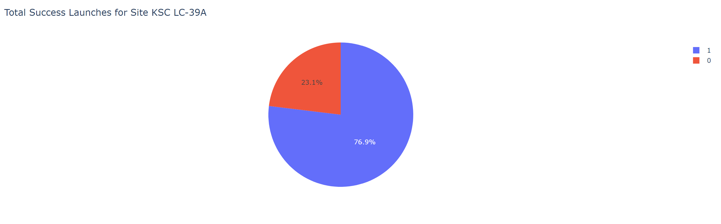
Launch Site with the Highest Launch Success Rate
The chart shows that KSC LC-39A has a 76.9% success rate and a 23.1% failure rate.

Slide 41
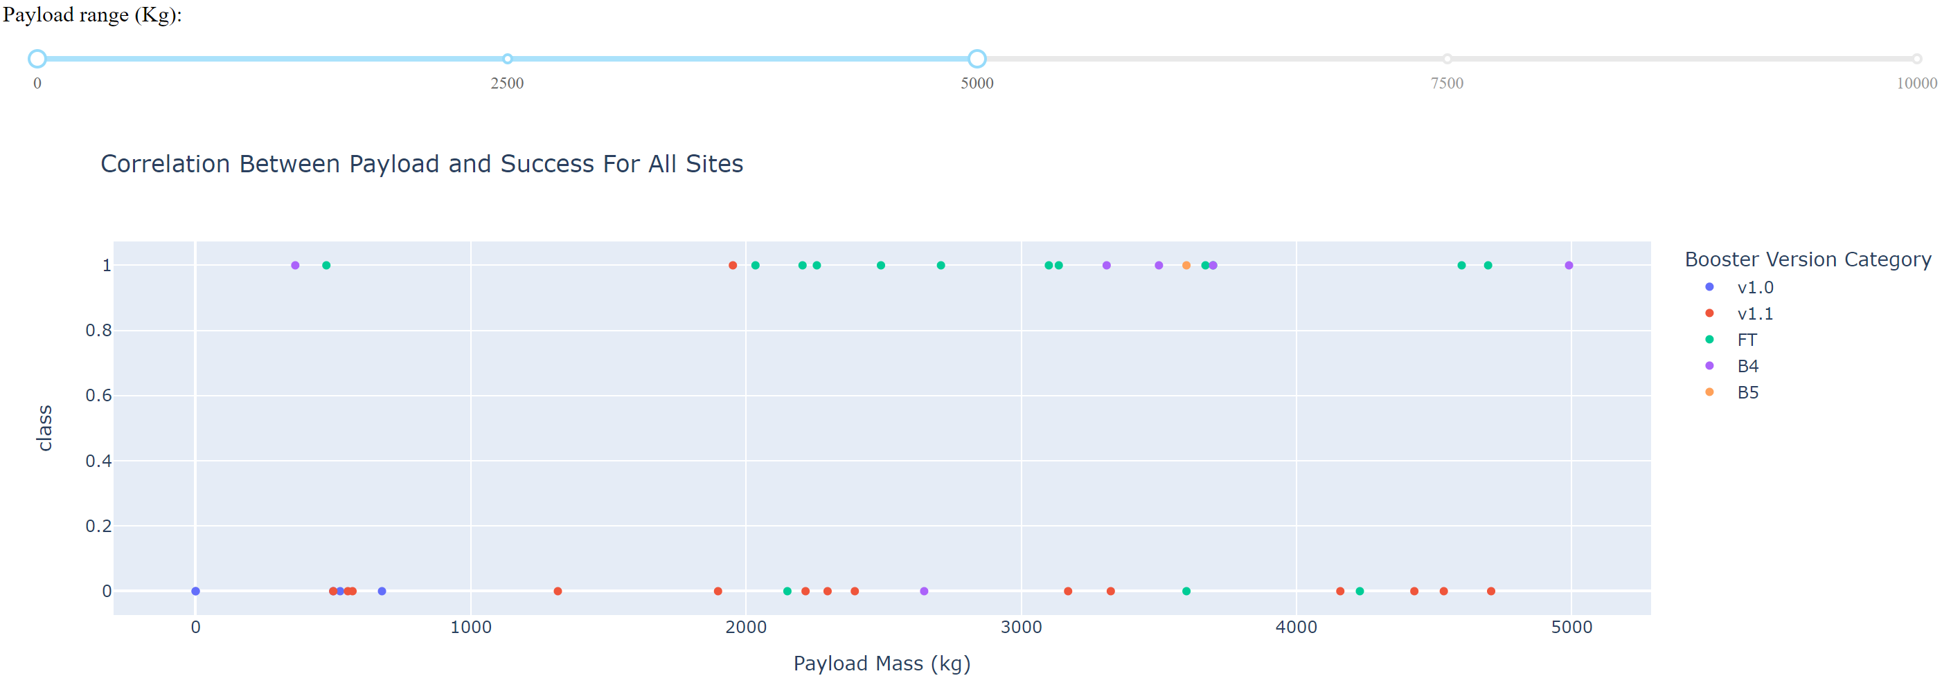
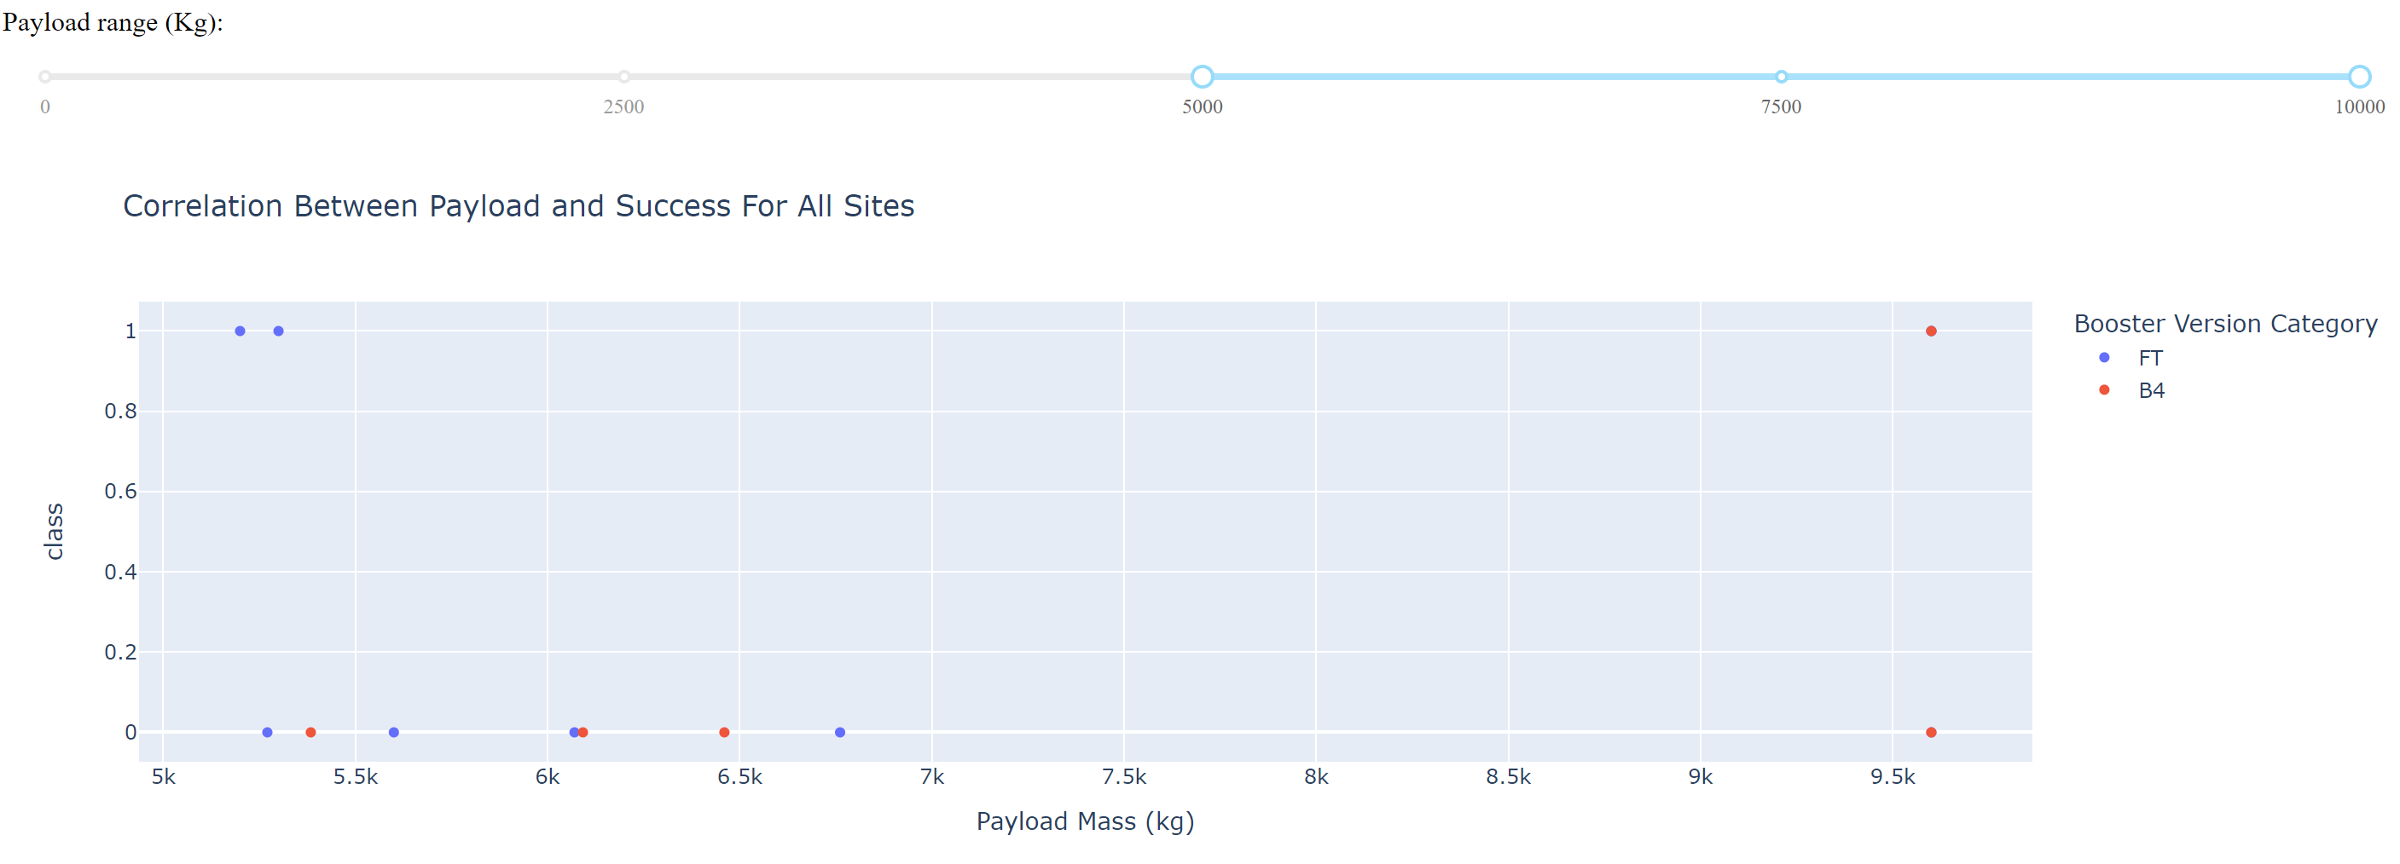
Payload Mass vs. Success Rate for All Launch Sites
The scatterplot shows that light payloads have better success rates than heavy payloads.

Slide 42

Section 5

Slide 43
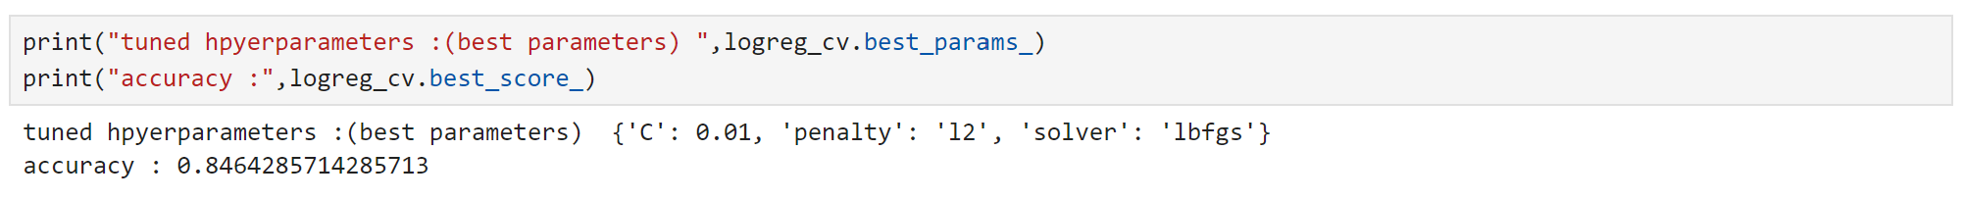
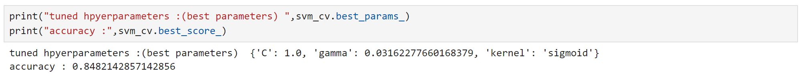
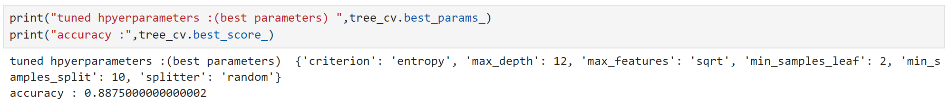
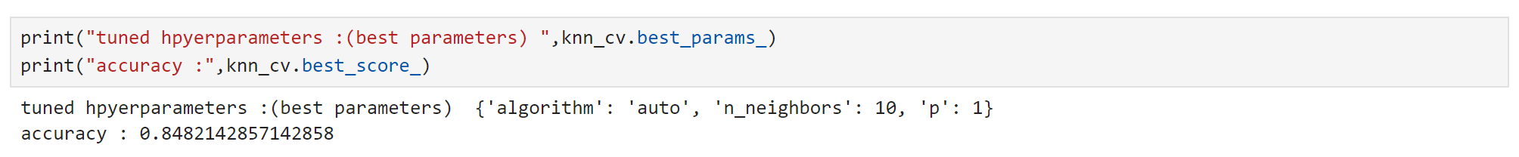
Classification Accuracy
LogReg
The accuracy for the test data on all the models are the same.
However, for the training data, the decision tree model had the highest accuracy.
SVM
Tree
KNN

Slide 44

Confusion Matrix
The confusion matrix for the decision tree model clearly shows the classifier can distinguish between the different classes.
The major problem comes from false positives. In this context, the classifier marks a failed landing as a successful landing.

Slide 45
Conclusions
Factors such as orbit type, number of previous launches, and payload mass influence whether a space mission will be successful.
Orbits with the best successful rates: ES-L1, GEO, HEO, and SSO.
The successful rate started to increase in 2013.
We can assume that knowledge has been gained between launches, which in turn, increases the probability of a successful launch.
KSC LC-39A was the launch site with the highest number of successful launches.
More information should be gathered as to why some launch sites are better than others.
Light payloads perform better than heavy payloads.
The decision tree model had the best train accuracy.

Slide 46


